Slide 1
Survival Analysis in Decision Modeling
Petros Pechlivanoglou
Anna Heath

Slide 2
Reconstruction of IPD
Anna Heath

Slide 3
Background
Decision modelling is often (at least in part) based on previously published data.
In survival analysis, published data for outcomes is frequently insufficient to perform cost-effectiveness analysis
Extrapolation of survival curves past the trial follow-up time requires individual patient data (IPD)
We aim to use published graphics to reconstruct IPD so published data can be used in a CEA.

Slide 4
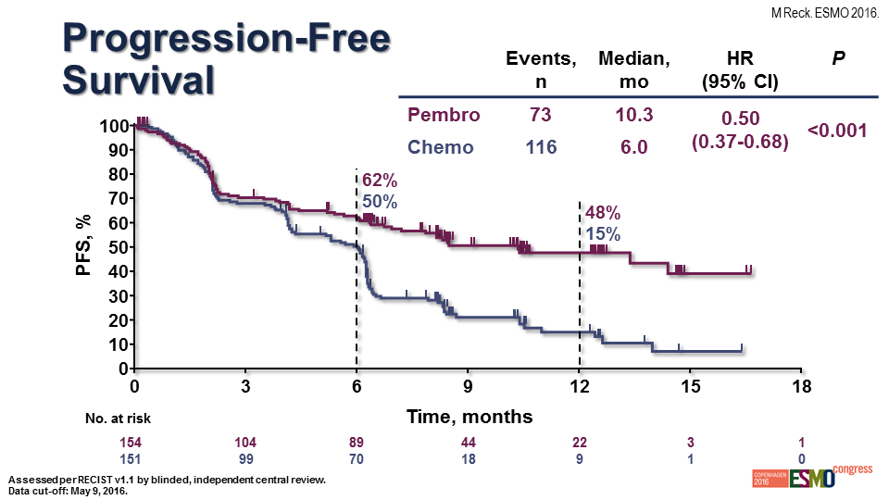
Published Kaplan-Meier Data

Slide 5
Published Kaplan-Meier Data

Slide 6
Published Kaplan-Meier Data

Slide 7
Published Kaplan-Meier Data

Slide 8
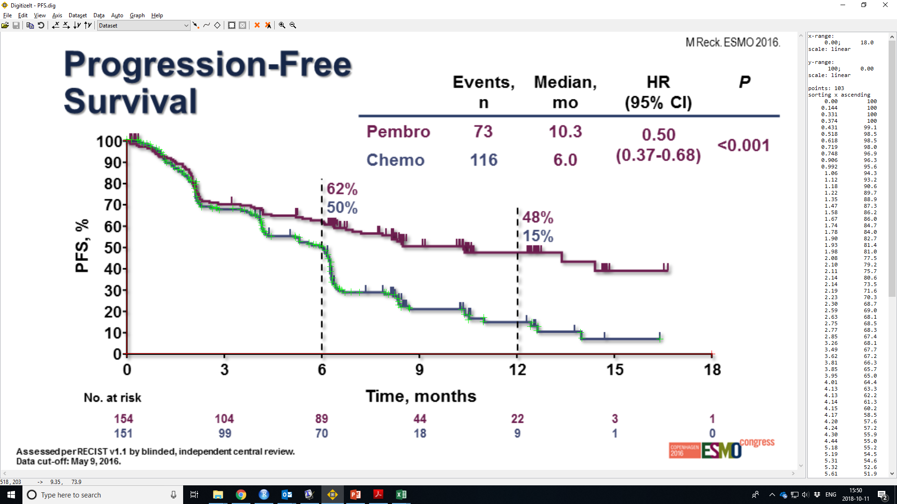
“Digitizing” the curves
https://www.digitizeit.de/

Slide 9
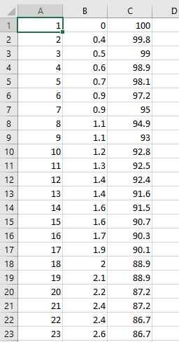
“Digitizing” the curves
The index number of click
The value on the x-axis – the time.
The value on the y-axis – the proportion of patients “alive” at that specific time point.

Slide 10
“Digitizing” the curves
The index number of click
The value on the x-axis – the time.
The value on the y-axis – the proportion of patients “alive” at that specific time point.
The times must be increasing
The survival proportions must be decreasing.
This needs to be checked manually because digitization can be imprecise

Slide 11
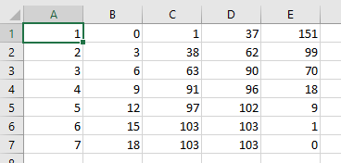
Tabulating the number “at risk”
The index number for the interval
The time at the beginning of the interval
Creates a link between the digitized curves and the “At Risk” table – this is index of the first click that is within the interval
This is the index of the last click that is within the interval
The number of patients at risk at the beginning of the interval

Slide 12
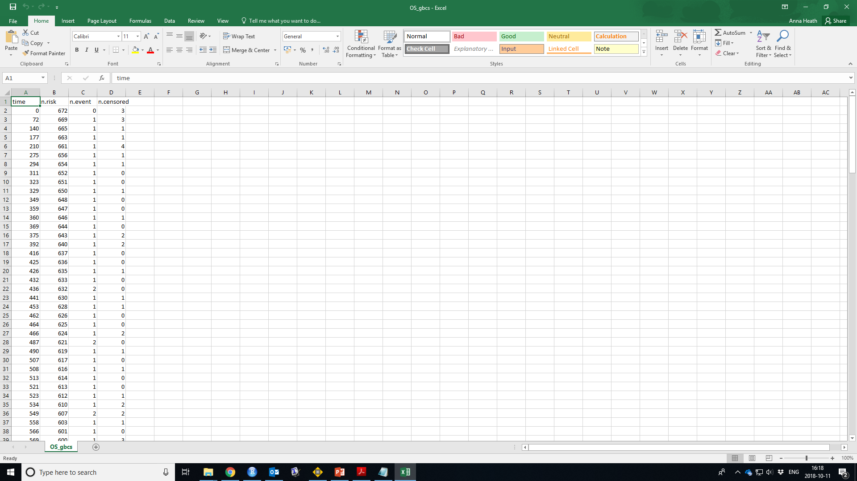
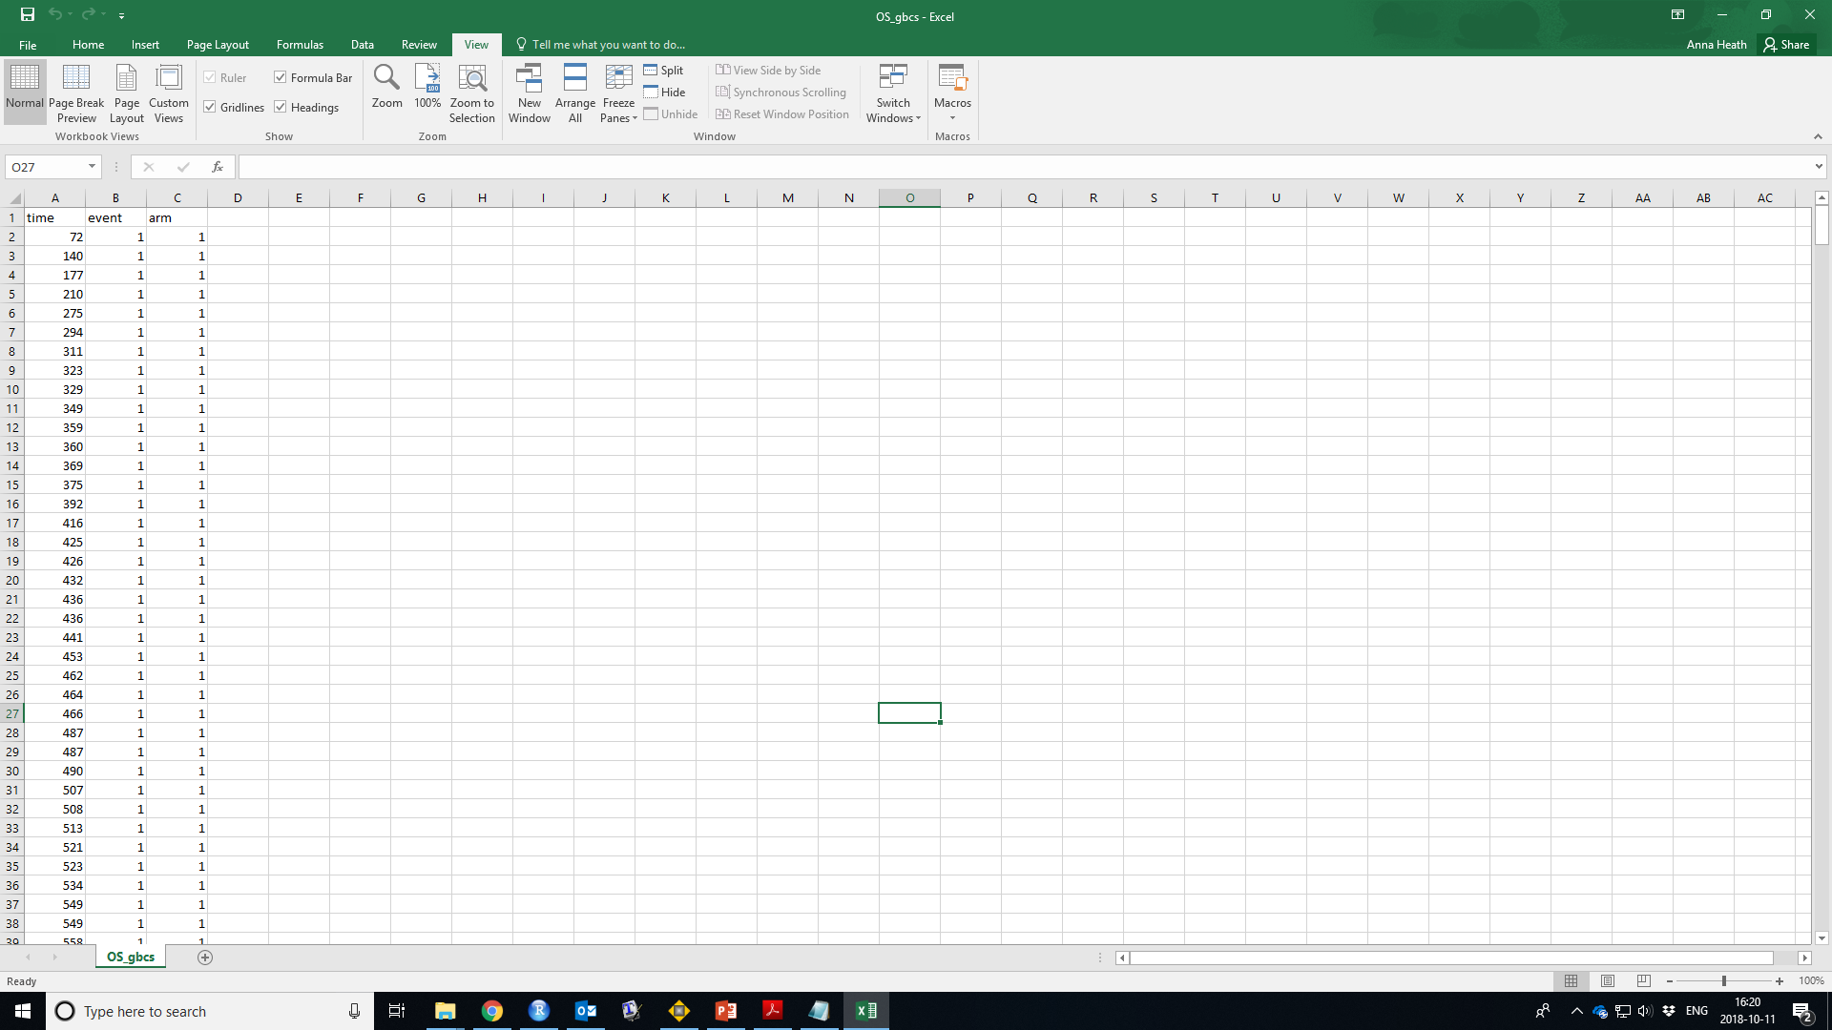
Creating the “pseudo” IPD
Guyot et al. developed an algorithm to reconstruct the IPD from these two files.
It is included in R in the package survHE.
> library(survHE)
> digitise("DIGITIZED.txt","ATRISK.txt",
km_output="KMdata.txt",ipd_output="IPDdata.txt")
This creates two datasets:

Slide 13
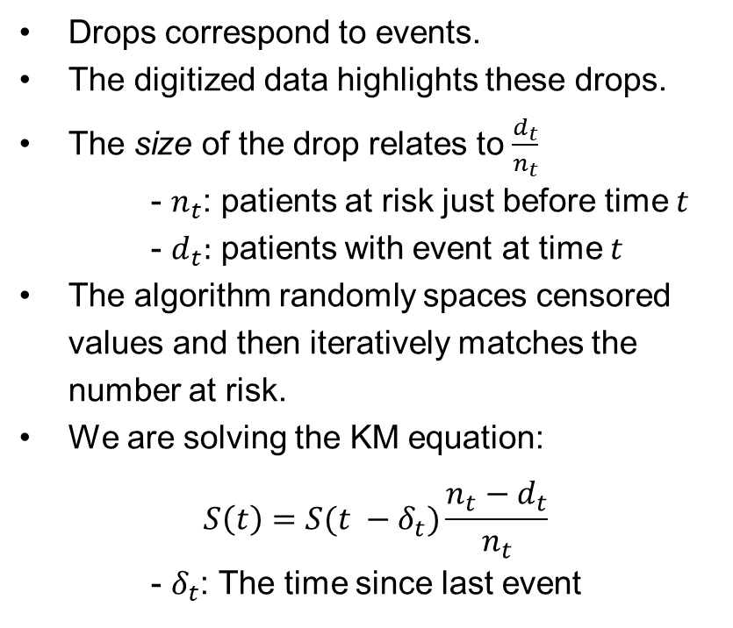
Creating the “pseudo” IPD

Slide 14
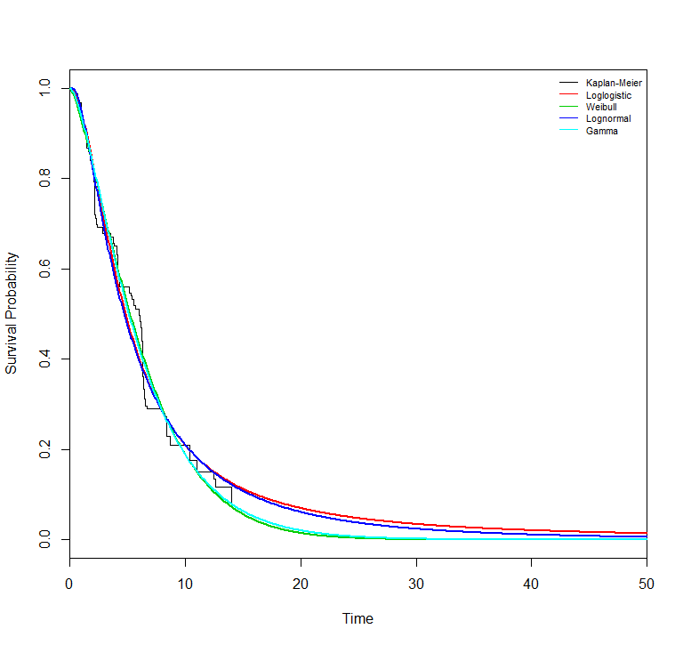
Model Fitting using pseudo IPD
Parametric survival models can be fitted as normal to the reconstructed IPD.
The best fitting model can be selected using standard model fitting criterion.
Extrapolation to the full model horizon can be achieved.
Partitioned survival analysis can be used to value health states.

Slide 15
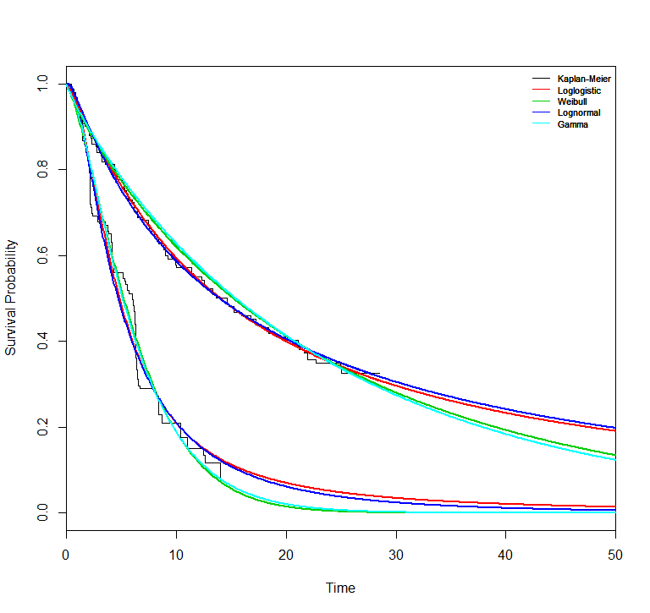
Limitations
There are no links between the curves:
Relationships between linked outcomes (e.g. PFS and OS) are not preserved.
Data cannot be used to inform a multi-state model
Cannot perform any subgroup analysis, e.g. by age, tumour category unless these curves are available and have been digitized

